Slide 1
Nashville, TN Police Stops
STAT 515 Final Project
Doug Cady

Slide 2
Why Police Stops?

Slide 3

Purpose
Data Description
Overpolicing
Racial injustice
Poverty
Nashville, Tennessee Police
9 year time period (2010 - 2018)
~ 3 million rows (1 per stop)
44 columns
Size: 1 GB
Saved as .rds file

Slide 4
Additional Data Sources

Slide 5

Income Data
Shapefile
Justicemaps.org
Census tract level
Variables:
2018 median household income
Population by race
Data.nashville.gov
Zip codes shapefile
Boundaries of Davidson County
R sf package ingests shapefile
R tmap package to plot it

Slide 6
Exploring Police Stops Dataset

Slide 7
Variables
Types:
<date>
<time>
<continuous>
<categorical>
<categorical>
<categorical>
<logical>
<logical>
Date - year, month, day
Time of day - hour, minute
Latitude, longitude (geospatial)
Subject age, sex, race
Violation (reason for stop)
Stop outcome
Search conducted
Contraband found

Slide 8
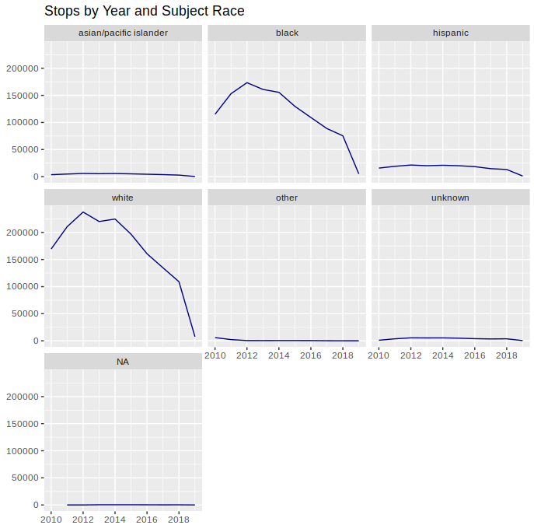
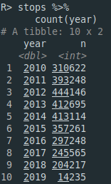
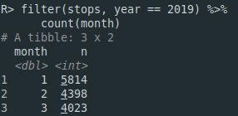
Time-series
What is our time frame?
Is every year representative?
Stops by year 2019 Stops by Month

Slide 9
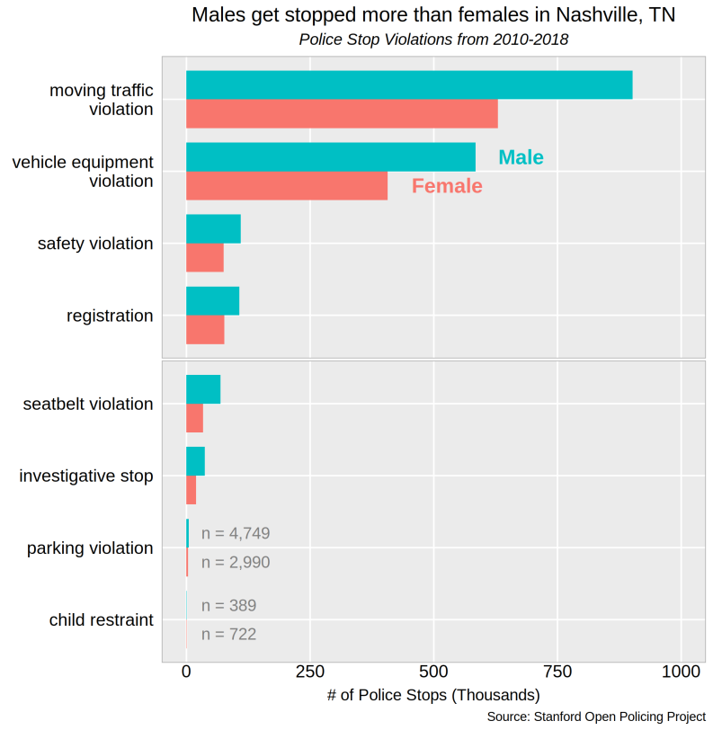
Violations by Sex
Breakdown by sex
Males stopped more than females across most categories

Slide 10
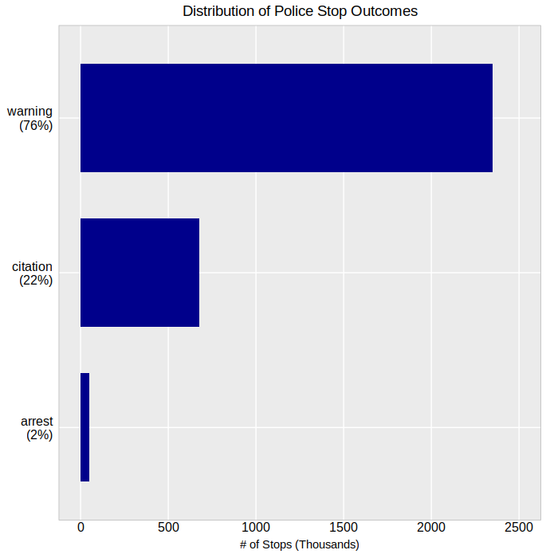
Stop Outcomes
Warning is most common
No summons

Slide 11
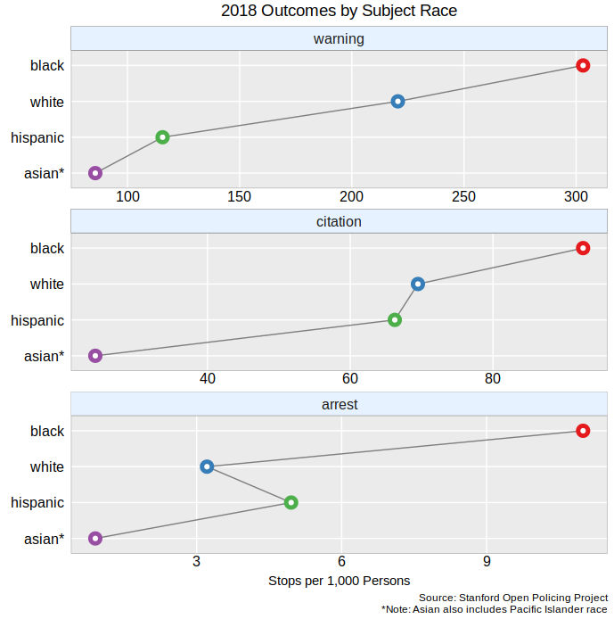
Outcomes by Race
Stops are scaled by population size
Black persons at top of each outcome category
Note: *Asian includes Pacific Islander

Slide 12
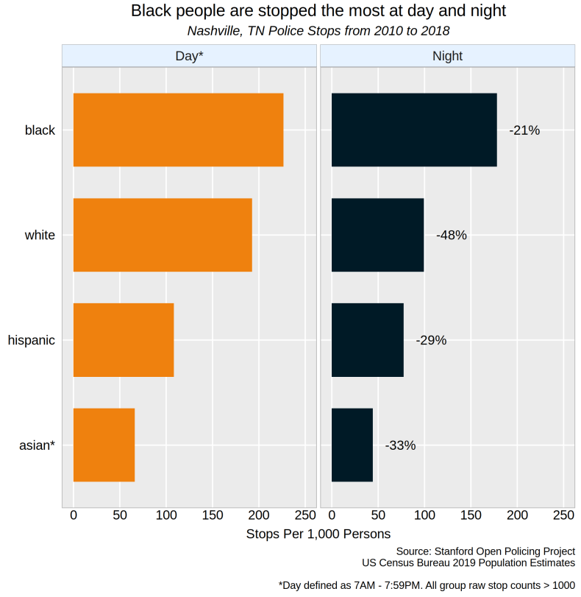
Stops by Time of Day
Day = 7AM - 7:59 PM
Black persons are stopped the most at day and night
Note: *Asian includes Pacific Islander

Slide 13
Modeling

Slide 14
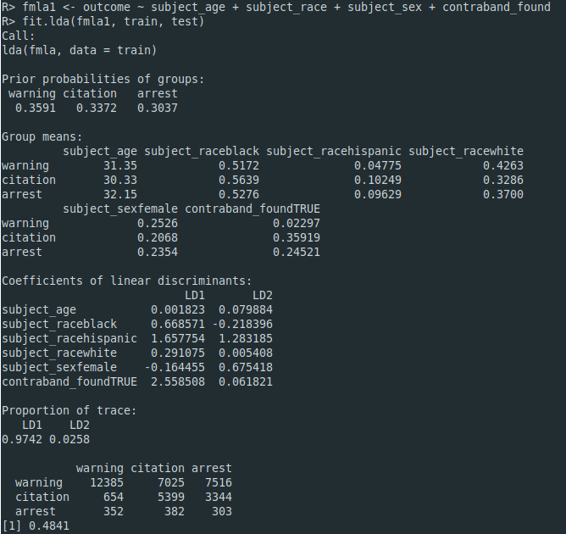
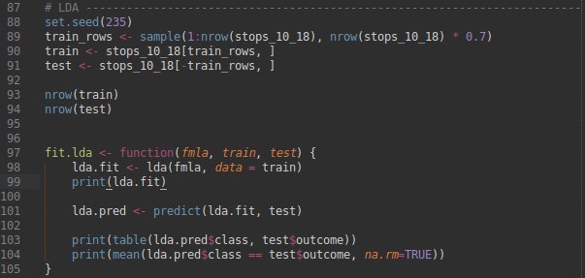
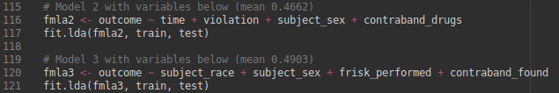
Linear Discriminant Analysis (LDA)
Similar to logistic regression
Better at multiple-class classification
Our outcome variable has 3 classes - warning, citation, arrest
Split data into training and test sets
Measure result as MSE and confusion matrix
Model 2 was a bit worse, while model 3 was slightly better

Slide 15
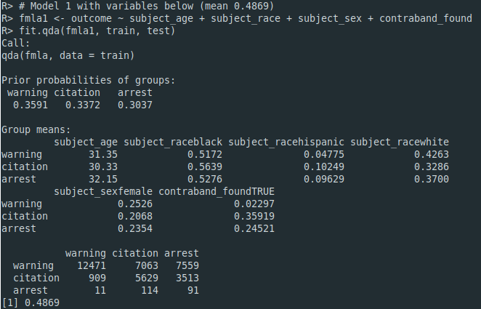
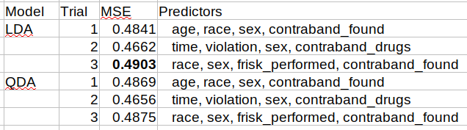
Quadratic Discriminant Analysis (QDA)
More flexible than LDA
LDA better with few observations when reducing variance is key
QDA trades higher variance for lower bias
Model results so far:

Slide 16
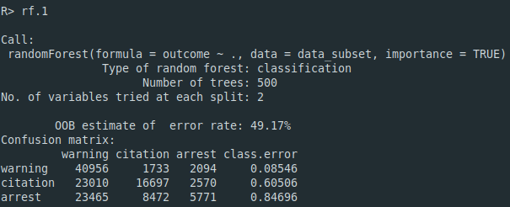
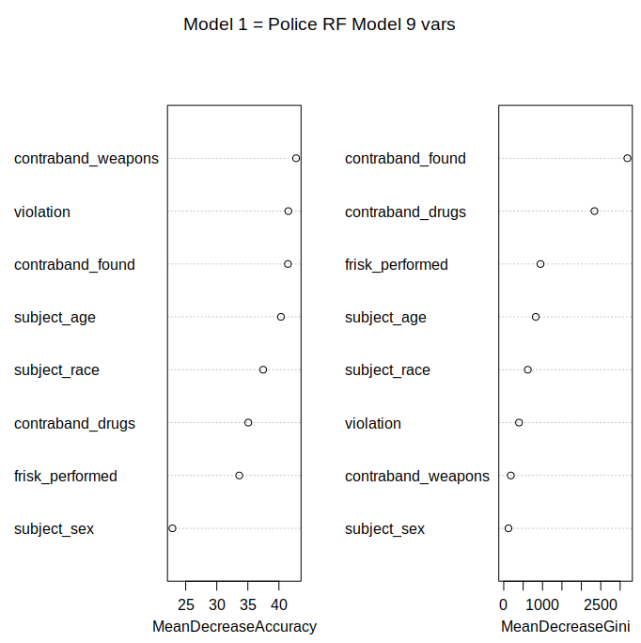
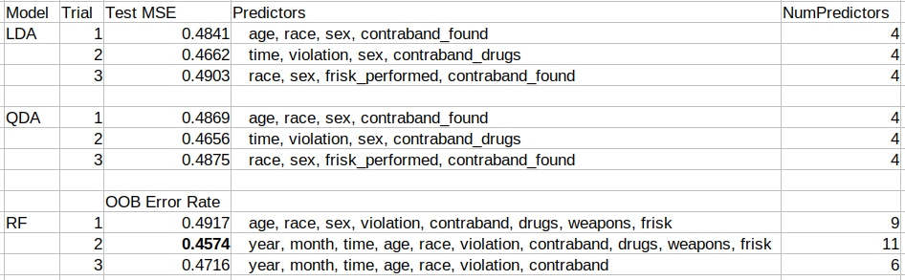
Random Forest (RF)
Default 500 trees
2 vars per split
Longer to run (fit and predict)
  LDA - 30s
  QDA - 30s
  RF - 48s
Variable Importance Plot:
Model results so far:

Slide 17
Interactive Plot

Slide 18
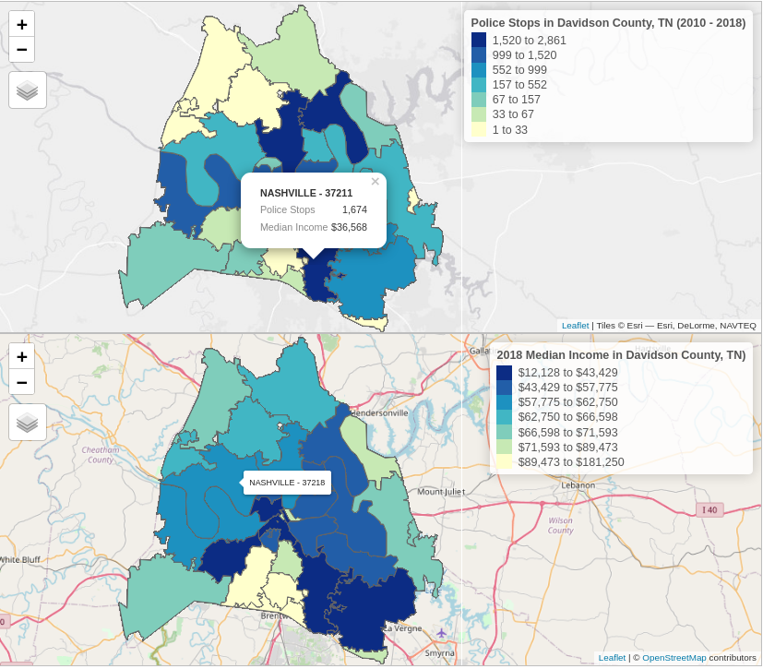
Choropleth Plot
Top - Police stops by zip code
Bottom - Median income by zip code
Features: zoom, position dragging, click to see popup, hover for name and zip
Packages: sf, tmap, Rcolorbrewer

Slide 19
Special Efforts

Slide 20
Special Efforts
Police stop dataset has 3 million rows and 1 GB size
Finding a working interactive mapping package and shapefile
  Plotly, ggmap, leaflet, Shiny
Pulling median income data through API service

Slide 21
Sources

Slide 22
Sources
Data
Stanford Open Policing Project: https://openpolicing.stanford.edu/data/
Data.Nashville.gov (shapefile): https://data.nashville.gov/browse?tags=shapefile
Justicemap.org (median income): http://www.justicemap.org/include_map.php
  API url: http://www.spatialjusticetest.org/api.php
Programs and Packages
tmap examples: https://ourcodingclub.github.io/tutorials/spatial-vector-sf/#4-spatial-operations
sf binning police stop points (lat, lon to zipcode): https://stackoverflow.com/questions/50140707/how-to-merge-a-shapefile-with-a-dataframe-with-latitude-longitude-data
Using Spatial Data with R online book: https://cengel.github.io/R-spatial/mapping.html#web-mapping-with-leaflet

Slide 23
Conclusion

Slide 24
Next Steps
Explore other factors that may be causing discriminatory policing
Connect to socio-economic factors in communities
Expand to criminal justice systemic issues - bail, jury selection

Slide 25
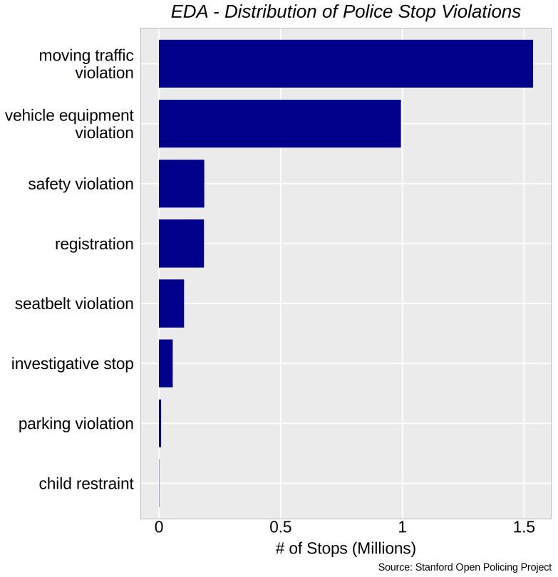
Violations (Stop Reason)
Most violation are moving traffic or vehicle equipment
High concentration in these 2 categories

